Slide 1

W E L C O M E
hy-tech camp:
building websites
Notes:
Note: Italicized text is meant as commentary/instruction. Unitalicized text is meant to be spoken directly.
Activity Preparation
Play some music in the background, like this: https://www.youtube.com/watch?v=MVPTGNGiI-4
Welcome the students as they arrive
Once everyone is seated, cut the music
Introduce yourselves and provide a little background
Move to the next slide

Slide 2
Agenda
Icebreaker
Presentation
Code-Along
Customization
Site Sharing
Blooket
Notes:
Here’s what we’ll be doing tonight!

Slide 3
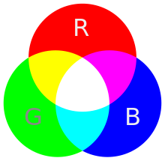
Icebreaker Activity: Coolors
Every color on the web can be represented by the amount of Red, Green, and Blue in it!
bit.ly/hytechcamps
Click Building Websites
Go to Coolors
Create a Color Scheme
Copy the link
Submit the form
Notes:
Introduce the icebreaker activity. Walk the students through each step, and make sure they all submit the form. View the responses, filter for the current room, and have each student introduce themselves and their color scheme.

Slide 4
Presentation
it’s time to learn about the web!
Notes:
Now it’s time to get into

Slide 5
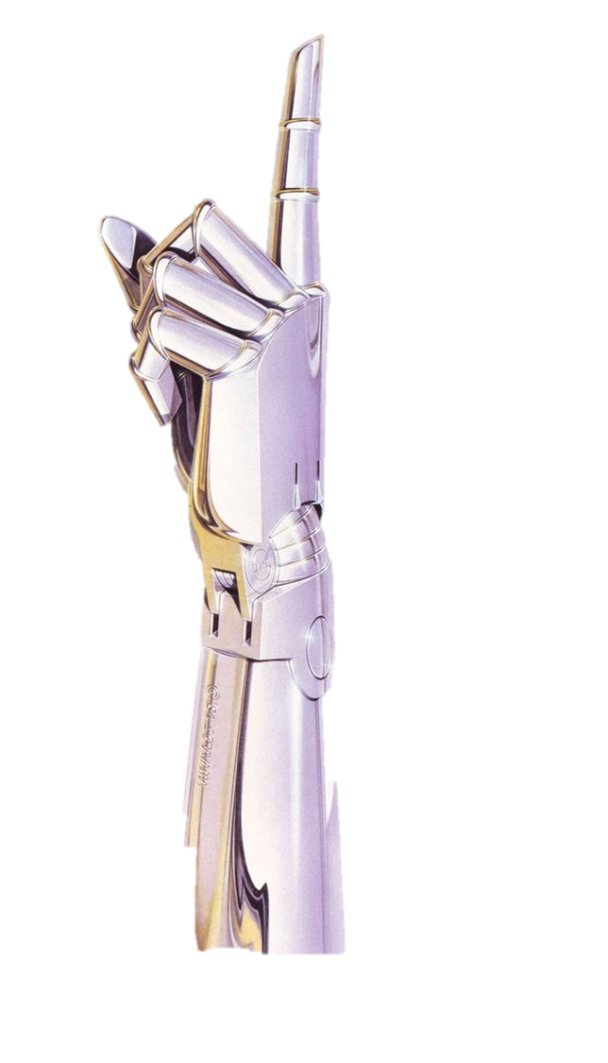
raise your hand if you have ever been to a website.
Notes:
Raise your hand if you’ve been to a website. Hopefully everybody has. What websites have you visited? Does anyone know how websites are made?

Slide 6
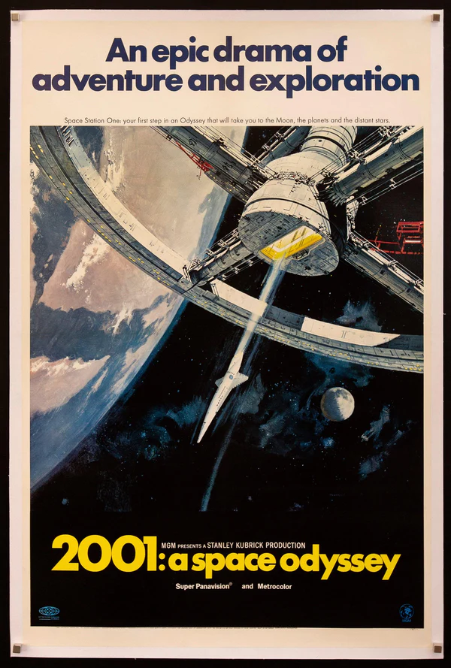
one example: Wikipedia
open Google Chrome
visit a page for a movie like 2001: A Space Odyssey
right click and select the View page source option
look at the HTML code that powers the site!
Notes:
Let’s take a look at an example. Has anyone been to Wikipedia before? We are going to visit a Wikipedia page, and take a look at the code that builds it. Can anyone name a movie?
Go to the Wikipedia page for a movie (or TV show, or music artist, or anything else), and follow the instructions on the slide. When viewing the source, explain that all the text is HTML code, and that the web browser (Google Chrome) interprets the code and makes it into a nice website. More info on the next slide.

Slide 7
HTML
HTML stands for HyperText Markup Language.
you can use HTML to build websites.
web browsers (like Google Chrome) take an HTML document and turn it into a nice looking page.
Notes:
Does anyone know what HTML is? Click.
It stands for HyperText Markup Language. Click.
You can use it to build websites. Click.
As we saw, web browsers like Chrome take all that garbled mess of code and turn it into a nice looking website!

Slide 8

HTML Elements
what’s something you’ve seen on a website?
text
pictures
every little thing on a website is an element.
links
videos
Notes:
Now let’s talk a bit about HTML elements. Can anyone tell me something you’ve seen on a website before? Click.
Some examples are text, links, pictures, and videos. Click.
All of these things are examples of HTML elements. Elements are the building blocks of a website, and we will learn how to use some different ones to create different components on a site.

Slide 9

The Code
Note: spaces and new lines don’t matter
what are these symbols?
an example HTML element: header
< >
<h1>Welcome</h1>
Element Name: h1
Opening Tag: <h1>
Content: Welcome
Closing Tag: </h1>
You may know them as greater-than and less-than signs, but another name for them is
angle brackets
Notes:
Now let’s talk about the code you can use to create HTML elements. First, some terminology. Click.
Anyone know what these things are? Click.
You may have seen these in math - they’re greater-than and less-than signs. In HTML, sometimes we call them angle brackets. Click.
Now here’s an example of how to use angle brackets to create a full HTML element - this is a header. There’s a lot going on here, so let’s break it down. Click.
First, the element name here is h1. Click.
The opening tag is this part, with the angle brackets surrounding the element name. This tells the web browser that the element has begun. Click.
Next, there is the content - it says Welcome. Click.
Finally, there is the closing tag - this is just like the opening tag, but with a slash before the element name. This tells the web browser that the element has ended. Click.
When the web browser sees this code, it will turn it into a header, like this! This is just one example of an element, but if you can understand this structure, it will be super helpful for any new elements we use. Click.
One note: spaces and new lines don’t matter, and sometimes will automatically be added. But HTML isn’t the only language we’re going to use today…

Slide 10

CSS Style
CSS is a language that lets you customize styles.
it stands for Cascading Stylesheets.
you can change things like colors, fonts, and sizing.
if HTML is the body of a website, CSS is the clothing that it wears
Notes:
We are also going to use CSS to add style to our websites. Click.
CSS is a language that lets you customize styles. Click.
It stands for Cascading Stylesheets. Click.
You can change the appearance of almost anything on your website, including colors, fonts, and sizing. Click.
If HTML is the body of a website, CSS is kind of like the clothing it wears - it won’t change the actual content, but it can change how it is presented.

Slide 11
Code-Along Activity
it’s time to build your own website!
Notes:
Now let’s get coding! Where exactly will we be coding?

Slide 12

The friendly community where everyone builds the web
Notes:
We are going to code using Glitch. It let’s you write code for websites and share them across the web! Click.
Glitch is known as the friendly community where everyone builds the web. Let’s take a look.

Slide 13
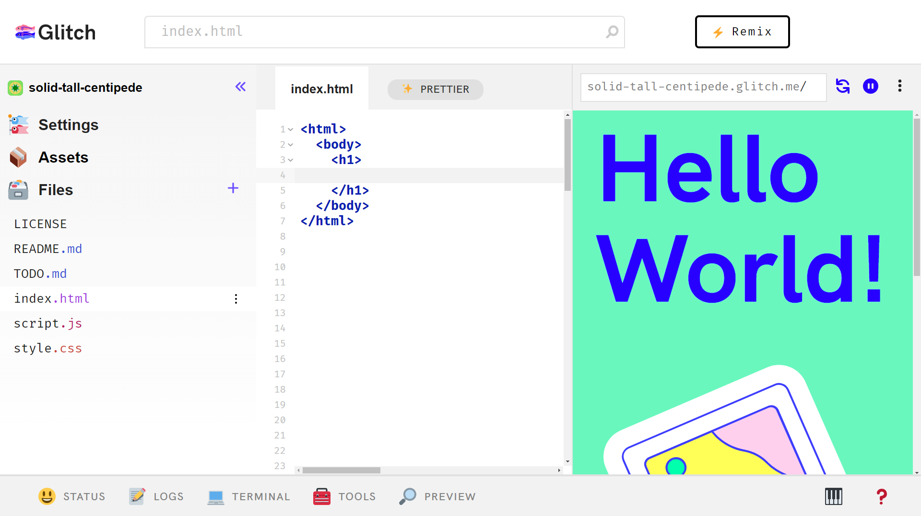
Update preview
Manage files
Write code
Glitch Overview
Open preview
Preview the site
Notes:
A Glitch project consists of a few different parts. First, there’s the code editor. Click.
This is where you can write the code for your website. It’s right in the middle of the page. But where does the actual site go? Well, we need to preview it! Click.
Clicking the PREVIEW button with the magnifying glass will allow you to preview the site you’re building. Click.
The preview shows up on the right! Click.
On the left, there’s the file management pane – this is your folder where you can swap files and add more. Click.
Finally, there’s the Refresh button at the top of the preview – that’s how you update your preview so it uses your latest code.

Slide 14
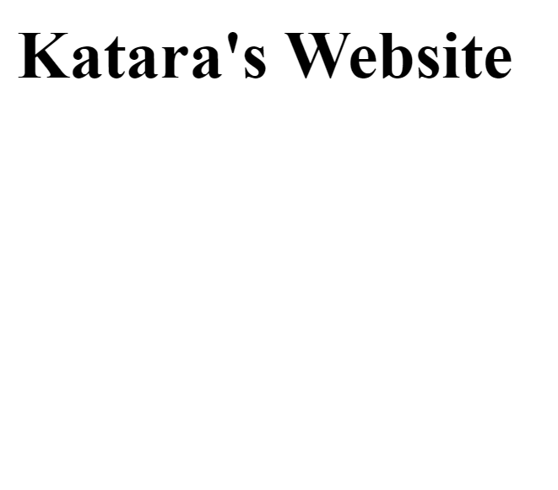
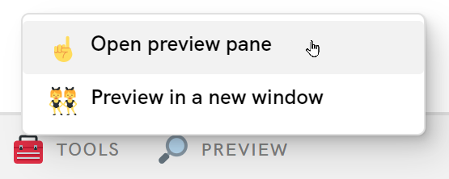
Getting Started
bit.ly/hytechcamps
Click Building Websites
Click under Code-Along
Open Preview Pane
CHALLENGE: Make this your website instead of Katara’s!
Notes:
Now let’s do it! Click.
Go back to the lesson homepage. Click.
Under where it says “Code-Along” click the link! Click.
Make sure to open the preview pane. The preview should appear on the right. Click.
Now for your first task… try to change the name on the website so it reflects your name!
Continue the code-along following the guide.

Slide 15
Customization
it’s time to make your site your own!
Notes:
Direct the students to the Customization guide. It shows some other cool things that are possible with HTML and CSS.

Slide 16
Site Sharing
it’s time to share your sites!
Notes:
Show students how to share their sites.

Slide 17
Blooket
it’s time to see what you learned!
Notes:
End the camp with the Blooket.

